Slide 1
Thursday, 1/5/2025 Lecture 1 (10:00-11:00): Quantum Mechanics in 1 hour Lecture 2 (11:15-12:15): Applied Quantum Mechanics Friday, 2/5/2025 Lecture 3 (10:00-11:00): Materials properties from atoms Lecture 4 (11:15-12:15): Collective phenomena: from plasticity to radiation damage

Slide 2
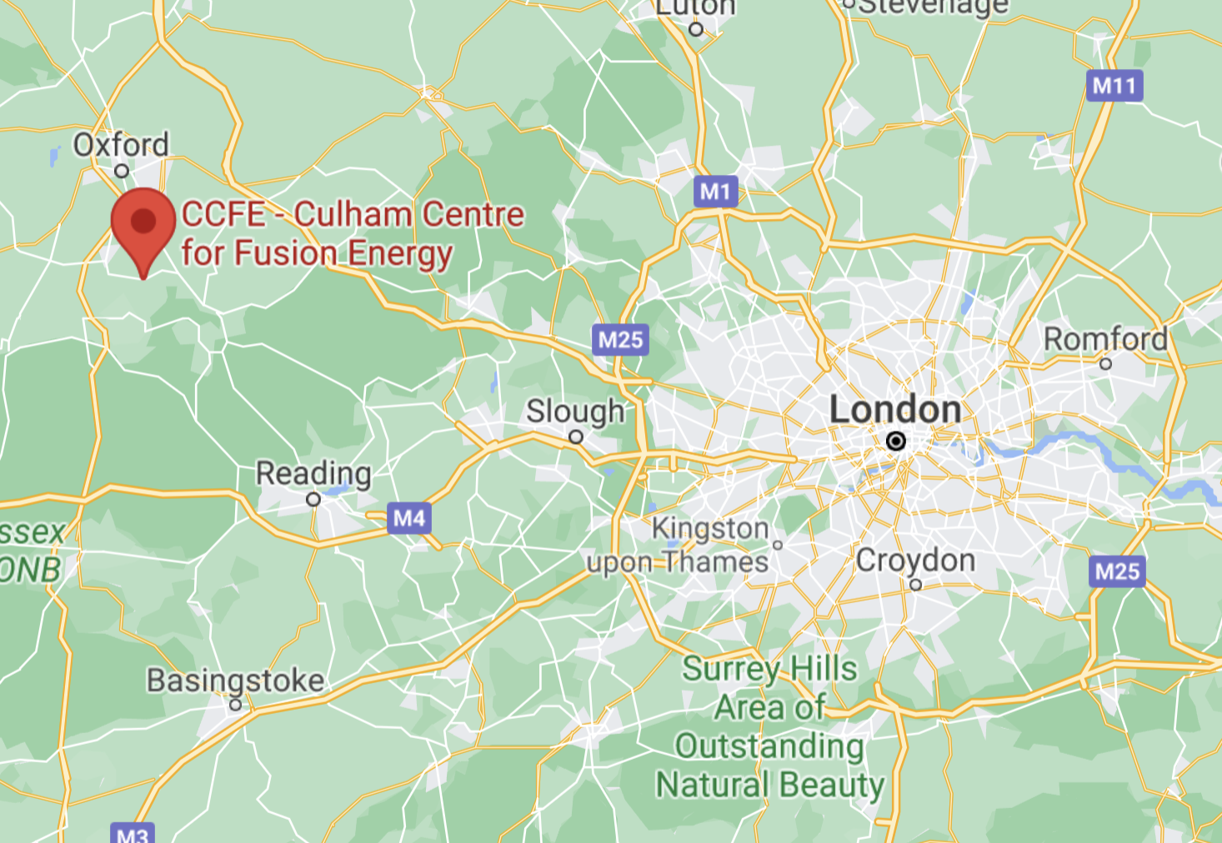
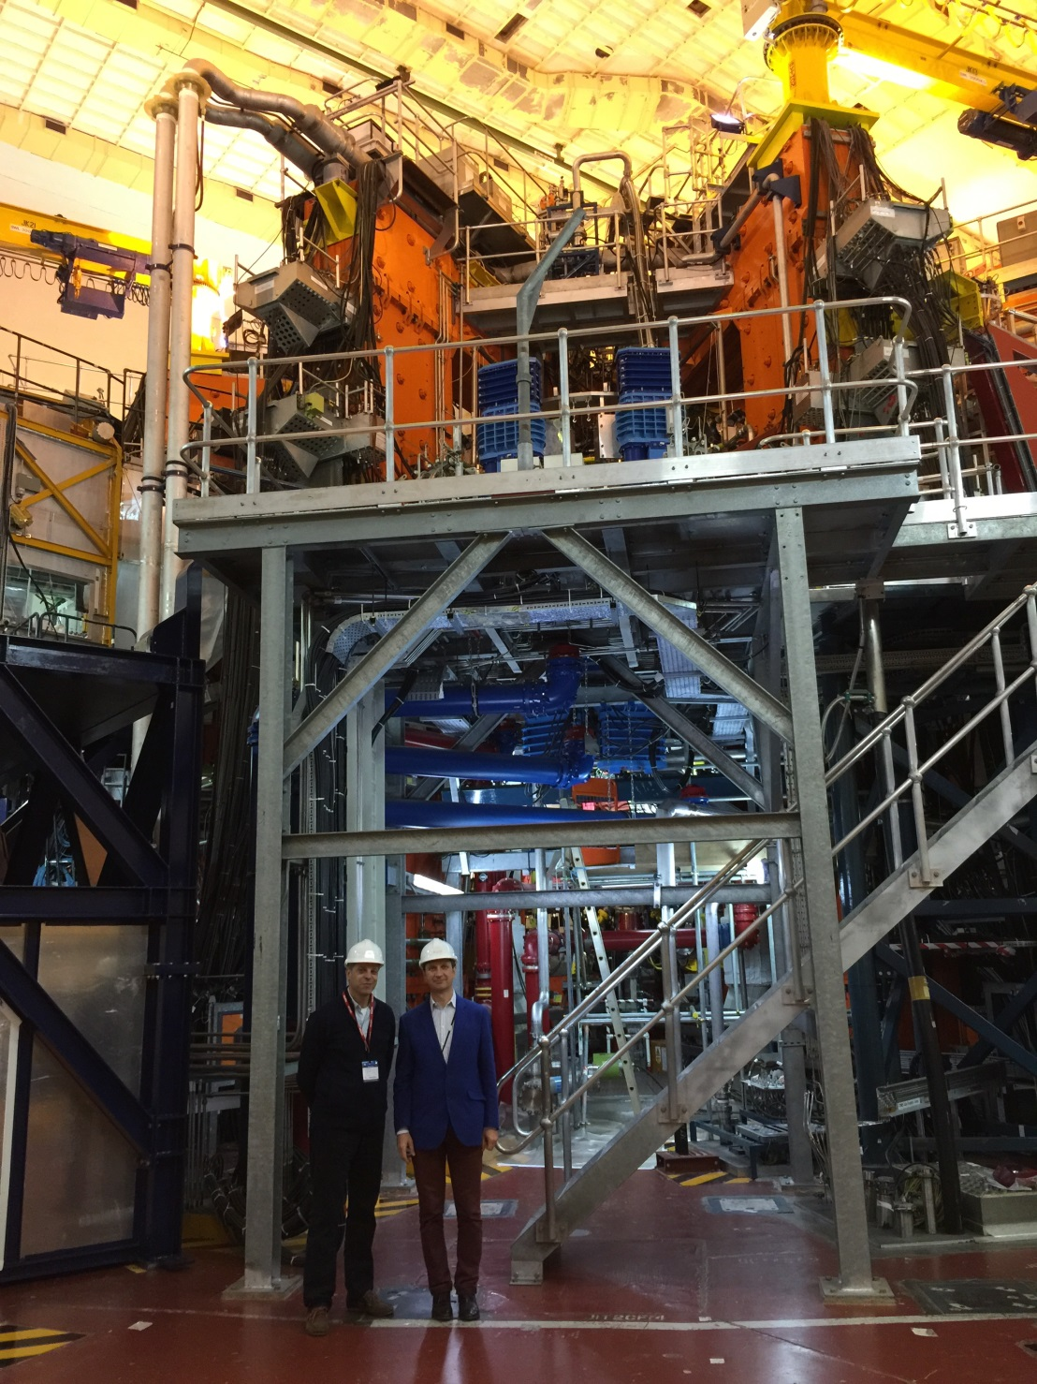

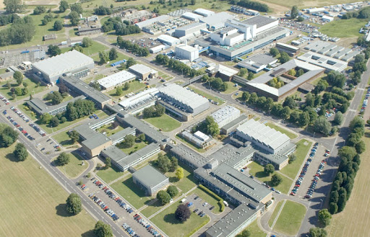

UK Atomic Energy Authority: Culham Campus
The JET torus
Materials Modelling Group:
Sergei L. Dudarev
Daniel R. Mason
Luca Reali
Andrew R. Warwick
Samanyu Tirumala
Sanjeet Kaur
Sho Hayakawa
JET
me

Slide 3
Lecture 1: Quantum Mechanics in 1 hour

Slide 4

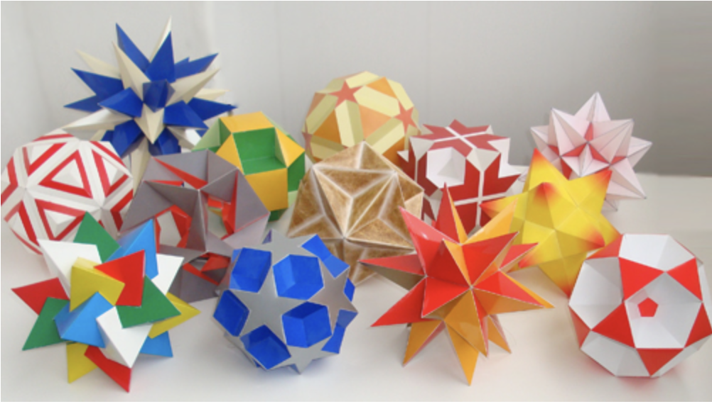
From atoms to materials
Greek: atomos ‘indivisible’, based on a- ‘not’ + temnein - ’to cut’
“[…] divisibility of matter comes to an end, and the smallest possible fragments must be bodies with sizes and shapes, […]. The smallest and indivisible bodies he called "atoms”. […] they are infinite in numbers and come in infinitely many varieties, and they have existed forever and that these atoms are in constant motion in the void or vacuum. The middle-sized objects of everyday life are complexes of atoms that are brought together by random collisions.”
[…] the solidness of the material corresponded to the shape of the atoms involved.
[…] distinguished them from each other by their shape, their size, and the arrangement of their parts. […] connections were explained by material links in which single atoms were supplied with attachments: some with hooks and eyes, others with balls and sockets.
Dēmókritos, "laughing philosopher”
Greek philosopher c. 460 – c. 370 BC11
Since then, our view developed, through theory and experiments:
Dalton | 1804 | Atoms are tiny, indivisible, identical for a given element
Thomson | 1899 | e⁻ homogeneously reside in atoms, mediating currents
Rutherford | 1911 | Positive charge of an atom is concentrated in a “nucleus
Bohr | 1915 | e⁻ move in trajectories with quantised angular momentum
Broglie | 1924 | All particles have an associated wave
Schrödinger | 1926 | Particles are described by wave-functions
Collection of polyhedra. Reminiscent of Dēmókritos’ atoms?
https://polyhedr.com/polyhedra.html, accessed 06/05/2025

Slide 5
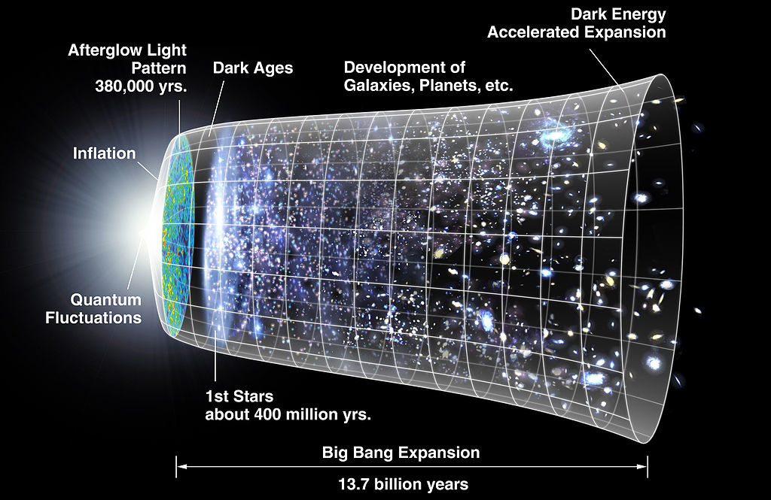
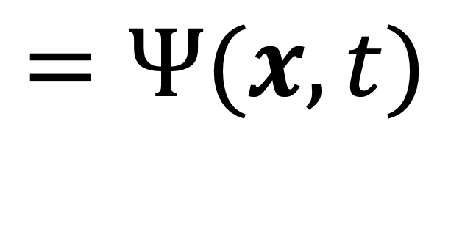
Schrödinger equation
$$=Ψ(x,t)$$
Universe
Wikipedia: NASA/WMAP Science Team
Courtesy of Pui-Wai (Leo) Ma

Slide 6
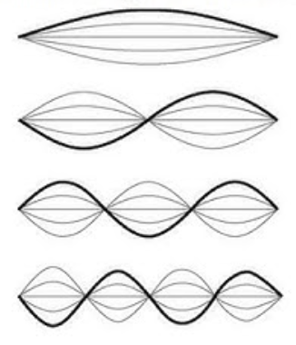
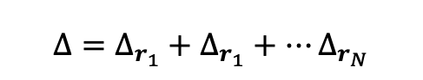
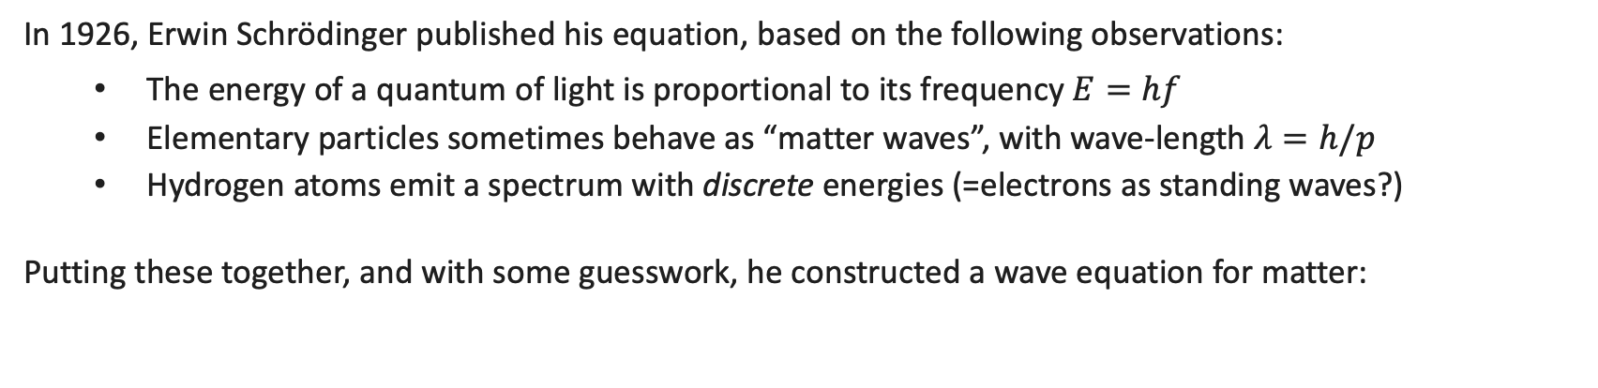
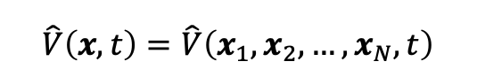


Schrödinger equation
In 1926, Erwin Schrödinger published his equation, based on the following observations:
The energy of a quantum of light is proportional to its frequency $E=hf$
Elementary particles sometimes behave as “matter waves”, with wave-length $λ=h/p$
Hydrogen atoms emit a spectrum with discrete energies (=electrons as standing waves?)
Putting these together, and with some guesswork, he constructed a wave equation for matter:
$$iℏ\frac{∂}{∂t}Ψ\left(x,t\right)=\left[−\frac{ℏ^{2}}{2m}Δ+\hat{V}(x,t)\right]Ψ\left(x,t\right)$$
$$Ψ\left(x,t\right)=Ψ\left(x_{1},x_{2},…, x_{N},t\right)$$
$$Δ=Δ_{r_{1}}+Δ_{r_{1}}+…Δ_{r_{N}}$$
$$\hat{V}\left(x,t\right)=\hat{V}\left(x_{1},x_{2},…, x_{N},t\right)$$
Wave-function amplitude depending on
Laplacian operator
operator for particle-interaction energies or external potentials
$x_{i}=\left(r_{i},s_{i}\right),$ position and spin state of particle $i$
$$Δ_{r_{i}}=∂_{x_{i}}^{2}+∂_{y_{i}}^{2}+∂_{z_{i}}^{2}$$
Schrödinger, E. "An undulatory theory of the mechanics of atoms and molecules." Phys. Rev. 28.6 (1926): 1049.

Slide 7

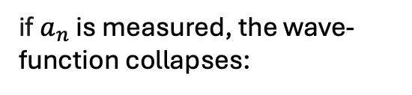
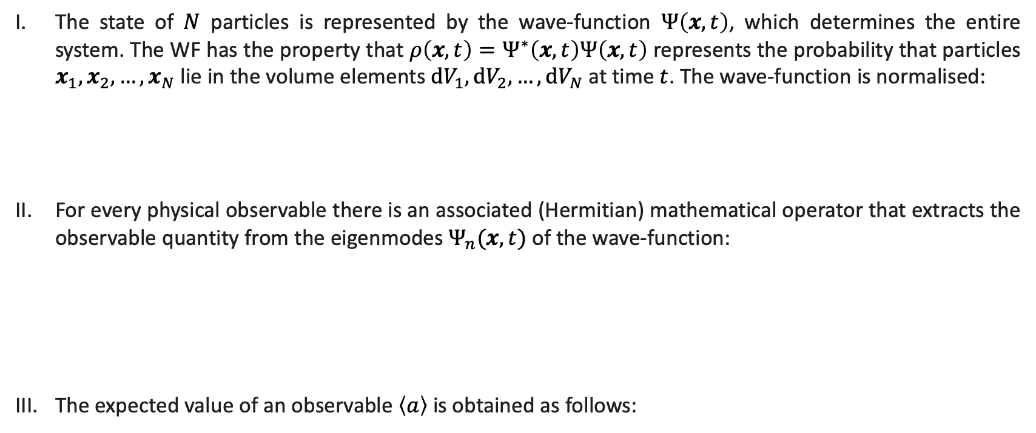

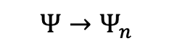

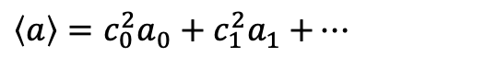

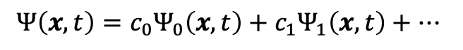
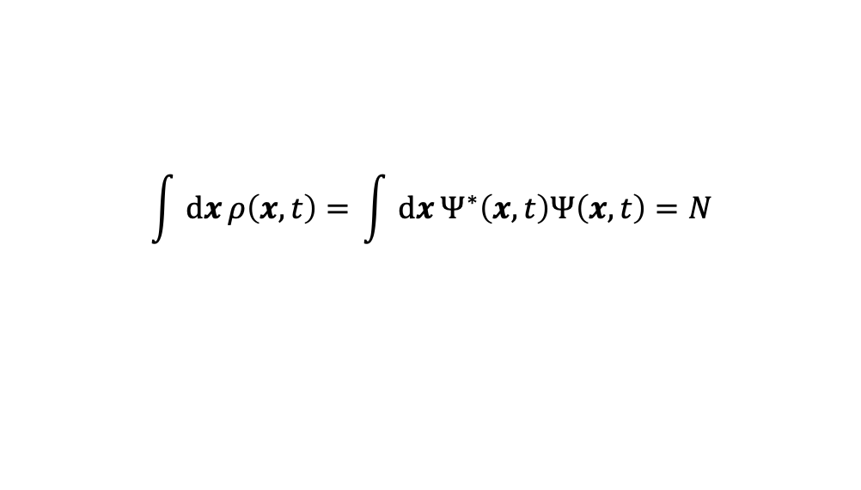
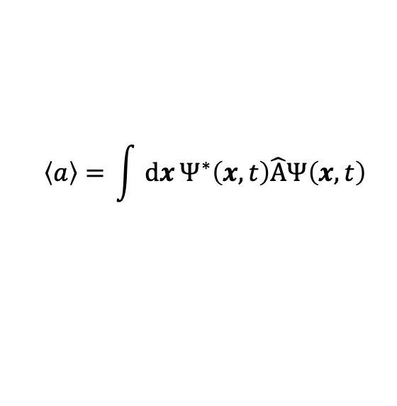

(Some) Quantum-mechanical postulates
The state of $N$ particles is represented by the wave-function $Ψ\left(x,t\right)$, which determines the entire system. The WF has the property that $ρ\left(x,t\right)=Ψ^{∗}\left(x,t\right)Ψ\left(x,t\right)$ represents the probability that particles $x_{1},x_{2},…,x_{N}$lie in the volume elements $dV_{1},dV_{2},…,dV_{N}$ at time $t$. The wave-function is normalised:
For every physical observable there is an associated (Hermitian) mathematical operator that extracts the observable quantity from the eigenmodes $Ψ_{n}(x,t)$ of the wave-function:
The expected value of an observable $\left\langle a\right\rangle$ is obtained as follows:
$$\int{dx}ρ\left(x,t\right)=\int{dx}Ψ^{∗}\left(x,t\right)Ψ\left(x,t\right)=N$$
example operators:
$$\hat{A}Ψ_{n}(x,t)=a_{n}Ψ_{n}(x,t)$$
$$\hat{E}=iℏ∂_{t}$$
$$\hat{x}=x$$
discrete observables!
$$\hat{p}=−iℏ∇$$
$$\left\langle a\right\rangle =\int{dx}Ψ^{∗}\left(x,t\right)\hat{A}Ψ\left(x,t\right)$$
if $a_{n}$ is measured, the wave-function collapses:
$$Ψ\left(x,t\right)=c_{0}Ψ_{0}\left(x,t\right)+c_{1}Ψ_{1}\left(x,t\right)+…$$
$$≡⟨Ψ|\hat{A}|Ψ⟩$$
$\left\langle a\right\rangle =c_{0}^{2}a_{0}+c_{1}^{2}a_{1}$ $+…$
$$Ψ→Ψ_{n}$$

Slide 8
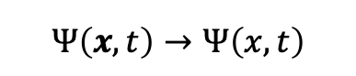
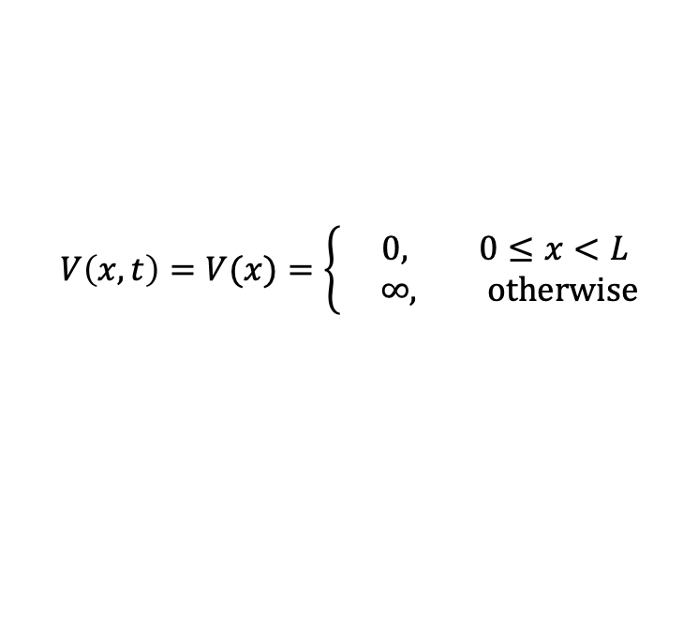
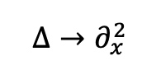
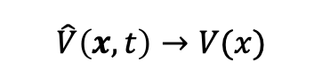
Particle in a one-dimensional well
To understand how to use Schrödinger’s equation in practice, consider the esteemed “particle in a well” problem.
Let the wave-function describe a single particle evolving in a stationary 1D potential of the form:
$$V\left(x,t\right)=V(x)=\left\{ \begin{aligned}0, 0≤x<L \\ ∞, otherwise\end{aligned}\right.$$
In one dimension, the Schrödinger equation (SE) reduces to:
$$iℏ\frac{∂}{∂t}Ψ\left(x,t\right)=\left[−\frac{ℏ^{2}}{2m}Δ+\hat{V}(x,t)\right]Ψ\left(x,t\right)$$
$$Ψ\left(x,t\right)→Ψ\left(x,t\right)$$
$$Δ→∂_{x}^{2}$$
$$\hat{V}\left(x,t\right)→V(x)$$
$$iℏ\frac{∂}{∂t}Ψ\left(x,t\right)=−\frac{ℏ^{2}}{2m}\frac{∂^{2}}{∂^{2}x}Ψ\left(x,t\right)$$

Slide 9
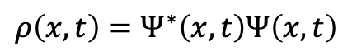

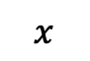
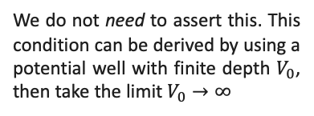
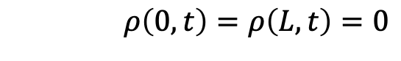
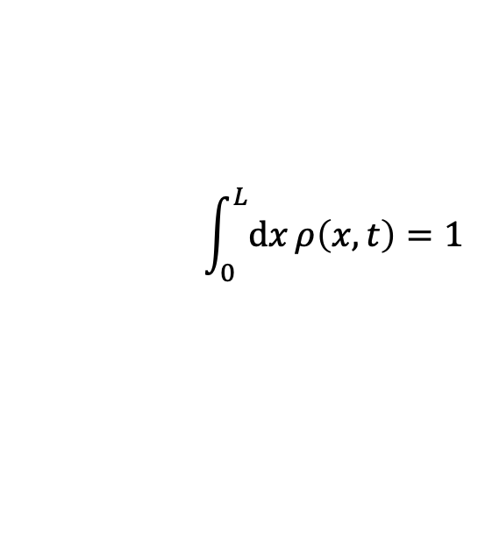

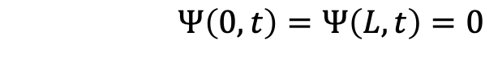

Particle in a one-dimensional well
To understand how to use Schrödinger’s equation in practice, consider the esteemed “particle in a well” problem.
Let the wave-function describe a single particle evolving in a stationary 1D potential of the form:
$$V\left(x,t\right)=V(x)=\left\{ \begin{aligned}0, 0≤x<L \\ ∞, otherwise\end{aligned}\right.$$
Starting from an initial wavefunction ${Ψ\left(x,t=0\right)≡Ψ}_{0}(x)$, we seek the time-evolving solution to SE subject to the constraints:
$$ρ\left(x,t\right)=Ψ^{∗}\left(x,t\right)Ψ\left(x,t\right)$$
$$ρ\left(0,t\right)=ρ\left(L,t\right)=0$$
We do not need to assert this. This condition can be derived by using a potential well with finite depth $V_{0}$, then take the limit $V_{0}→∞$
$$Ψ\left(0,t\right)=Ψ\left(L,t\right)=0$$
$$\int_{0}^{L}{dx}ρ\left(x,t\right)=1$$
The probability to find the particle inside the well is always 100%
$$x$$
$$0$$
$$L$$

Slide 10
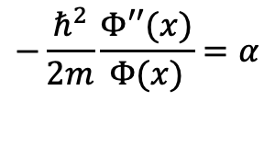
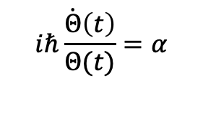
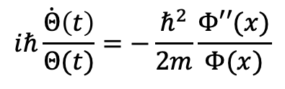
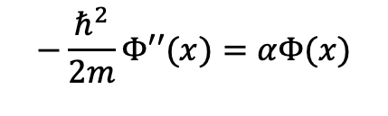
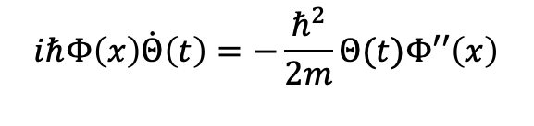
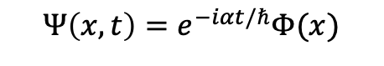
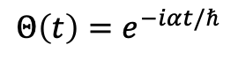
Particle in a one-dimensional well
$$iℏ\frac{∂}{∂t}Ψ\left(x,t\right)=−\frac{ℏ^{2}}{2m}\frac{∂^{2}}{∂^{2}x}Ψ\left(x,t\right)$$
Begin with the separation of variables Ansatz: $Ψ\left(x,t\right)=Θ\left(t\right)Φ(x)$
$$iℏΦ\left(x\right)\dot{Θ}\left(t\right)=−\frac{ℏ^{2}}{2m}Θ(t)Φ′′\left(x\right)$$
This results in the following relations:
$$Θ\left(t\right)=e^{−iαt/ℏ}$$
$$iℏ\frac{\dot{Θ}\left(t\right)}{Θ(t)}=−\frac{ℏ^{2}}{2m}\frac{Φ′′(x)}{Φ(x)}$$
$$Ψ\left(x,t\right)=e^{−iαt/ℏ}Φ(x)$$
Since neither function depends on the argument of the other, both sides must be equal to the same constant:
Eigenmodes? Eigenstates!
It remains to solve the time-independent problem:
$$iℏ\frac{\dot{Θ}\left(t\right)}{Θ(t)}=α$$
$$−\frac{ℏ^{2}}{2m}\frac{Φ′′(x)}{Φ(x)}=α$$
$$−\frac{ℏ^{2}}{2m}Φ′′(x)=αΦ(x)$$

Slide 11
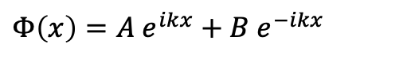
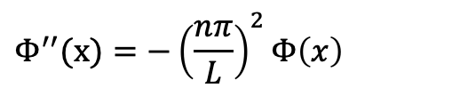

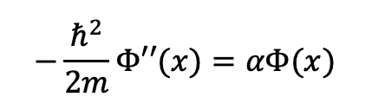

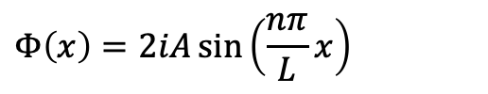
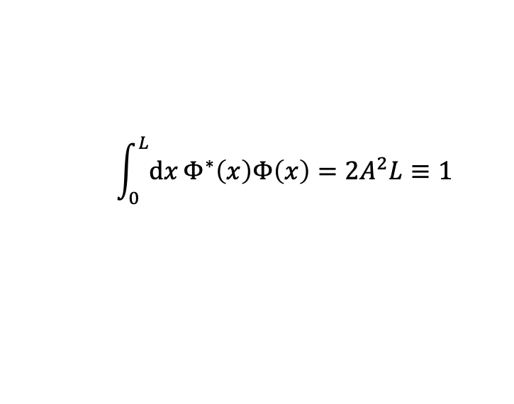

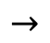

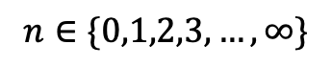
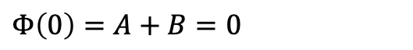


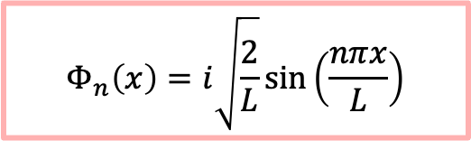
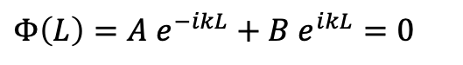

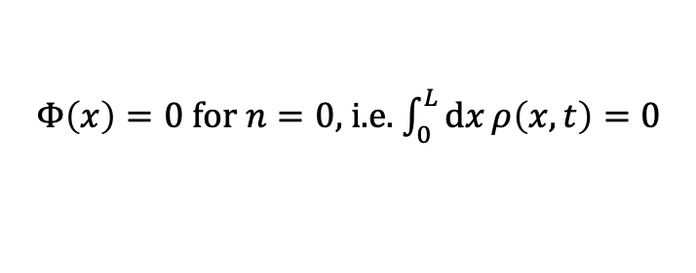
Particle in a one-dimensional well
$$−\frac{ℏ^{2}}{2m}Φ′′(x)=αΦ(x)$$
$$(⋆)$$
$$Φ\left(x\right)=2iA\sin\left(\frac{nπ}{L}x\right)$$
$$Φ^{′′}(x)=−{\left(\frac{nπ}{L}\right)}^{2}Φ\left(x\right)$$
Use the Ansatz:
$$Φ\left(x\right)=A e^{ikx}+B e^{−ikx}$$
Substitute into $(⋆)$ and solve for $α$:
Apply the boundary conditions…
$$α=\frac{{π^{2}ℏ}^{2}n^{2}}{2mL^{2}}$$
$$n∈\{1,2,3,…,∞\}$$
$$Φ\left(0\right)=A+B=0$$
$$Φ\left(L\right)=A e^{−ikL}+B e^{ikL}=0$$
Finally, apply normalisation condition:
$$\int_{0}^{L}{dx}Φ^{∗}\left(x\right)Φ\left(x\right)=2A^{2}L≡1$$
…to find the set of solutions satisfying them:
$$A=1/\sqrt{2L}$$
$$→$$
$$A=−B$$
$$Φ_{n}\left(x\right)=i\sqrt{\frac{2}{L}}\sin\left(\frac{nπx}{L}\right)$$
$$k=nπ/L$$
$$n∈\{0,1,2,3,…,∞\}$$
$Φ\left(x\right)=0$ for $n=0$, i.e. $\int_{0}^{L}{dx}ρ\left(x,t\right)=0$

Slide 12
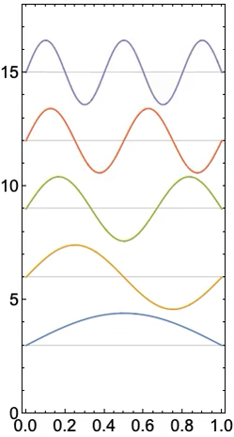
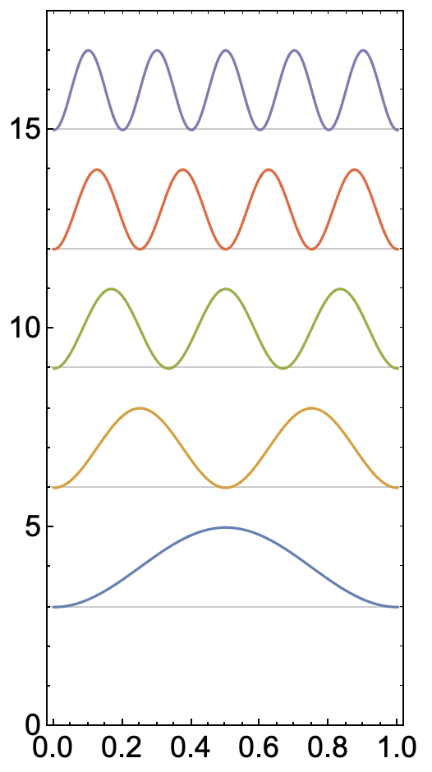

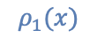
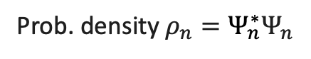
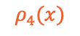























Particle in a one-dimensional well
Wave-function $Re(Ψ_{n})$
Prob. density $ρ_{n}=Ψ_{n}^{∗}Ψ_{n}$
Now that we have solved for the stationary states, i.e. the “eigenmodes”
and the time-dependent functions
we can assemble the full solution following the Ansatz:
$$ρ_{5}(x)$$
$$5$$
$$Ψ_{5}(x)$$
$$Φ_{n}\left(x\right)=i\sqrt{\frac{2}{L}}\sin\left(\frac{nπx}{L}\right),$$
$$ρ_{4}(x)$$
$$4$$
$$Ψ_{4}(x)$$
$$ρ_{3}(x)$$
state $n$
$$3$$
$$Ψ_{3}(x)$$
$$ρ_{2}(x)$$
$$Θ_{n}\left(t\right)=e^{−i\frac{π^{2}ℏn^{2}}{2mL^{2}} t},$$
$$2$$
$$Ψ_{2}(x)$$
$$ρ_{1}(x)$$
$$1$$
$$Ψ_{1}(x)$$
$$Ψ_{n}\left(x,t\right)=Φ_{n}\left(x\right)Θ_{n}\left(t\right)=i\sqrt{\frac{2}{L}}\sin\left(\frac{nπx}{L}\right)e^{−i\frac{π^{2}ℏn^{2}}{2mL^{2}} t}.$$
$$0$$
$$L$$
$$0$$
$$L$$
position $x$
position $x$

Slide 13






Particle in a one-dimensional well
Wave-function $Re(Ψ_{n})$
Prob. density $ρ_{n}=Ψ_{n}^{∗}Ψ_{n}$
Because the solutions form a complete orthonormal basis, we can express any initial wavefunction at $t=0$ in terms of the eigenstates and then propagate it in time:
$$ρ_{5}(x)$$
$$5$$
$$Ψ_{5}(x)$$
$$ρ_{4}(x)$$
$$φ\left(x\right)=Ψ\left(x,t=0\right)≡\sum_{n=1}^{∞}{c_{n}Φ_{n}\left(x\right)}$$
$$4$$
$$Ψ_{4}(x)$$
$$ρ_{3}(x)$$
To obtain expansion coefficients, make use of orthonormality:
state $n$
$$3$$
$$Ψ_{3}(x)$$
$$\int_{0}^{L}{dx}Φ_{n}^{∗}\left(x\right)φ\left(x\right)=\sum_{n=1}^{∞}{c_{n}\int_{0}^{L}{dx}Φ_{n}^{∗}\left(x\right)Φ_{n}\left(x\right)}$$
$$ρ_{2}(x)$$
$$2$$
$$Ψ_{2}(x)$$
$$ρ_{1}(x)$$
$$=\sum_{n=1}^{∞}{c_{n}δ_{nm}}=c_{m}$$
$$(⋆⋆)$$
$$1$$
$$Ψ_{1}(x)$$
$$δ_{nm}=\left\{ \begin{aligned}1, n=m \\ 0, otherwise\end{aligned}\right.$$
is the Kronecker Deta
$$0$$
$$L$$
$$0$$
$$L$$
position $x$
position $x$

Slide 14

















Particle in a one-dimensional well
Eigenmode expansion of Gaussian wave-functions $Re(Ψ)$
Example: Gaussian-shaped wavefunction
original
$$Ψ\left(x,t=0\right)≡Ae^{−α{\left(x−\frac{L}{2}\right)}^{2}}=\sum_{n=1}^{n_{max}}{c_{n}Ψ_{n}\left(x,t\right)},$$
α = 10
expansion
α = 150
α = 1000
where
$c_{n}=\int_{0}^{L}{dx}Φ_{n}^{∗}\left(x\right)φ\left(x\right)$.
see $(⋆⋆)$
$$0$$
position $x$
$$L$$
Time-evolution of the probability density $ρ=Ψ^{∗}Ψ$
Once we have the coefficients, we can evolve the probability density in time:
α = 10
α = 150
α = 1000
$$ρ\left(x,t\right)=Ψ^{∗}\left(x,t\right)Ψ\left(x,t\right)$$
$$=\sum_{n=1}^{n_{max}}{\sum_{m=1}^{n_{max}}{c_{n}^{∗}c_{m}Ψ_{n}^{∗}(x,t)Ψ_{m}(x,t)}}$$
$$0$$
position $x$
$$L$$

Slide 15





Particle in a one-dimensional well
Wave-function $Re(Ψ_{n})$
Prob. density $ρ_{n}=Ψ_{n}^{∗}Ψ_{n}$
Next, let us evaluate some observables:
$$ρ_{5}(x)$$
Energy:
$$\hat{E}=iℏ∂_{t}$$
$$Θ_{n}\left(t\right)=e^{−iα_{n}t/ℏ}$$
$$5$$
$$Ψ_{5}(x)$$
$$ρ_{4}(x)$$
$$E_{n}=\left\langle Ψ_{n}\left|\hat{E}\right|Ψ_{n}\right\rangle =Θ_{n}^{∗}\left(t\right)(iℏ∂_{t})Θ_{n}\left(t\right)=α_{n}$$
$$4$$
$$Ψ_{4}(x)$$
$=$ $\frac{{{π^{2}ℏ}^{2}n}^{2}}{2mL^{2}}$
Note $n≥1:$ zero-point energy!
$$ρ_{3}(x)$$
state $n$
$$3$$
$$Ψ_{3}(x)$$
$$ρ_{2}(x)$$
$$Ψ_{n}\left(x,t\right)=Φ_{n}\left(x\right){e^{−\frac{{iE}_{n}t}{ℏ }}}$$
$$2$$
$$Ψ_{2}(x)$$
$$ρ_{1}(x)$$
$$1$$
$$Ψ_{1}(x)$$
The above expression is general for time-independent Hamiltonians, e.g when there is no time-varying external potential.
$$0$$
$$L$$
$$0$$
$$L$$
position $x$
position $x$

Slide 16





Particle in a one-dimensional well
Wave-function $Re(Ψ_{n})$
Prob. density $ρ_{n}=Ψ_{n}^{∗}Ψ_{n}$
Next, let us evaluate some observables:
$$ρ_{5}(x)$$
Position:
$$E\left[x\right]=\left\langle Ψ_{n}\left|\hat{x}\right|Ψ_{n}\right\rangle =\int_{0}^{L}{dx}Ψ_{n}^{∗}\left(x,t\right)xΨ_{n}\left(x,t\right)=L/2$$
$$5$$
$$Ψ_{5}(x)$$
$$ρ_{4}(x)$$
$$Var\left[x\right]=\left\langle Ψ_{n}\left|{\hat{x}}^{2}\right|Ψ_{n}\right\rangle −E{\left[x\right]}^{2}=\frac{L^{2}}{12}\left(1−\frac{6}{n^{2}π^{2} }\right)$$
$$4$$
$$Ψ_{4}(x)$$
$$ρ_{3}(x)$$
Momentum:
state $n$
$$E\left[p\right]=\left\langle Ψ_{n}\left|\hat{p}\right|Ψ_{n}\right\rangle =\int_{0}^{L}{dx}Ψ_{n}^{∗}\left(x,t\right)(−iℏ∂_{x})Ψ_{n}\left(x,t\right)=0$$
$$3$$
$$Ψ_{3}(x)$$
$$ρ_{2}(x)$$
$$2$$
$$Var\left[p\right]=\left\langle Ψ_{n}\left|{\hat{p}}^{2}\right|Ψ_{n}\right\rangle −E{\left[p\right]}^{2}={\left(\frac{nπℏ}{L}\right)}^{2}$$
$$Ψ_{2}(x)$$
$$ρ_{1}(x)$$
$$1$$
$$Ψ_{1}(x)$$
$$\sqrt{Var\left[x\right]Var\left[p\right]}=\frac{ℏ}{2}\sqrt{\frac{n^{2}π^{2}}{3}−2}=σ_{x}σ_{p}>\frac{ℏ}{2}$$
$$0$$
$$L$$
$$0$$
$$L$$
position $x$
position $x$
This is an example of Heisenberg’s uncertainty principle.

Slide 17




The hydrogen atom
The first-principles derivation of hydrogen’s spectral lines was the first victory of quantum mechanics.
The SE including the electrostatic interaction between electron and proton is solvable, albeit challenging!
$$\left[−\frac{ℏ^{2}}{2m_{e}}Δ_{e}−\frac{ℏ^{2}}{2m_{p}}Δ_{p}−\frac{e^{2}}{4πε_{0}|{\hat{x}}_{e}−{\hat{x}}_{p}| }\right]Ψ\left(x_{e},x_{p}\right)=EΨ(x_{e},x_{p})$$
$$x_{e}$$
$$|x_{e}−x_{p}|$$
Trying to illustrate the hydrogen atom based on the above SE is somewhat pointless. Unlike in classical physics, where coordinates $x_{e}$ and $x_{p}$ refer to the positions of electron and nuclei, respectively, in QM, they instead represent coordinates of the 3-dimensional wavefunction $Ψ\left(x_{e},x_{p}\right)=Ψ_{e}\left(x_{e}\right)Ψ_{p}(x_{p})$.
$$x_{p}$$
This factorisation can be done because electrons are fermions, and protons are bosons. The deeper “why” is beyond this lecture.
Late comment: Actually this explanation is incorrect, as was pointed out by an astute listener: Protons are fermions! So why can we factorise this? This explanation needs to be amended for the next lecture.

Slide 18

The hydrogen atom
The first-principles derivation of hydrogen’s spectral lines was the first victory of quantum mechanics.
The SE including the electrostatic interaction between electron and proton is solvable, albeit challenging!
$$\left[−\frac{ℏ^{2}}{2m_{e}}Δ_{e}−\frac{ℏ^{2}}{2m_{p}}Δ_{p}−\frac{e^{2}}{4πε_{0}|{\hat{x}}_{e}−{\hat{x}}_{p}| }\right]Ψ\left(x_{e},x_{p}\right)=EΨ(x_{e},x_{p})$$
In the interest of time, we shall just sketch out the solution. It involves the following steps:
Decouple Hamiltonian into electron & proton parts by transforming it to the centre of mass reference frame
Change from Cartesian $(x,y,z)$ to spherical $(ρ,θ,φ)$ coordinates ($ρ$ is distance to centre of mass)
Apply a separation of variables Ansatz: $Ψ\left(ρ,θ,φ\right)=R\left(ρ\right)Θ\left(θ\right)Φ\left(φ\right)$
Solve the resulting PDEs for $R\left(ρ\right)$, $Θ\left(θ\right)$, and $Φ\left(φ\right)$separately
Much like for the 1D well, we identify “quantum numbers” associated with the solutions: $n$, $l$, and $m$

Slide 19








The hydrogen atom
The solution in its full glory:
normalisation prefactors
$$ψ_{nlm}\left(ρ,θ, φ\right)=\sqrt{{\left(\frac{2}{na_{0}^{∗}}\right)}^{3}\frac{\left(n−l−1\right)!}{2n\left(n+l\right)!}}e^{−\frac{ρ}{2}}ρ^{l}L_{n−l−1}^{2l+1}\left(ρ\right)Y_{l}^{m}(θ,φ)$$
quantum numbers
$$n=\{1,2,3,…\}$$
reduced Bohr radius
$$ρ=\frac{2r}{na_{0}^{∗}}$$
$$l=\{0,1,2, …,n−1\}$$
$$a_{0}^{∗}=\frac{4πε_{0}ℏ^{2}}{μe^{2}}$$
spherical harmonics
$m=\{−l, −l+1, …,l−1, l$}
gen. Laguerre polynomials
With the energy:
reduced mass
$$μ=\frac{m_{e}m_{p}}{m_{e}+m_{p}}$$
$$E_{n}=−\frac{e^{2}}{8πε_{0}a_{0}^{∗}n^{2}}=\frac{13.5983 eV}{n^{2}}$$

Slide 20

The hydrogen atom
You may recognise plots of “orbitals” from Chemistry, showing the probability density ${ρ_{nlm}=ψ}_{nlm}^{∗}ψ_{nlm}$:

